Slide 1
Principles for Agile Development
Phyllis Marbach, Agile Coach
The Boeing Company
April 15, 2015

Slide 2
Principles for Agile Development
How does the:
Manifesto for Agile Software Development [Beck 2001] and the
Principles behind the Agile Manifesto
Apply to systems, large programs with multiple teams of development, or systems engineers?
These principles are for:
Cross-functional teams that include systems and software engineers working on customer “pull” projects to produce software products
Programs with hardware development and software development
Help produce products more affordably in today’s global marketplace
Provide a foundation for working together to develop high-value capabilities iteratively.

Slide 3
Agile Manifesto
We are uncovering better ways of developing software by doing it and helping others do it. Through this work we have come to value:
Individuals and interactions over processes and tools
Working software over comprehensive documentation
Customer collaboration over contract negotiation
Responding to change over following a plan
That is, while there is value in the items on the right, we value the items on the left more.”[Beck, 2001]

Slide 4
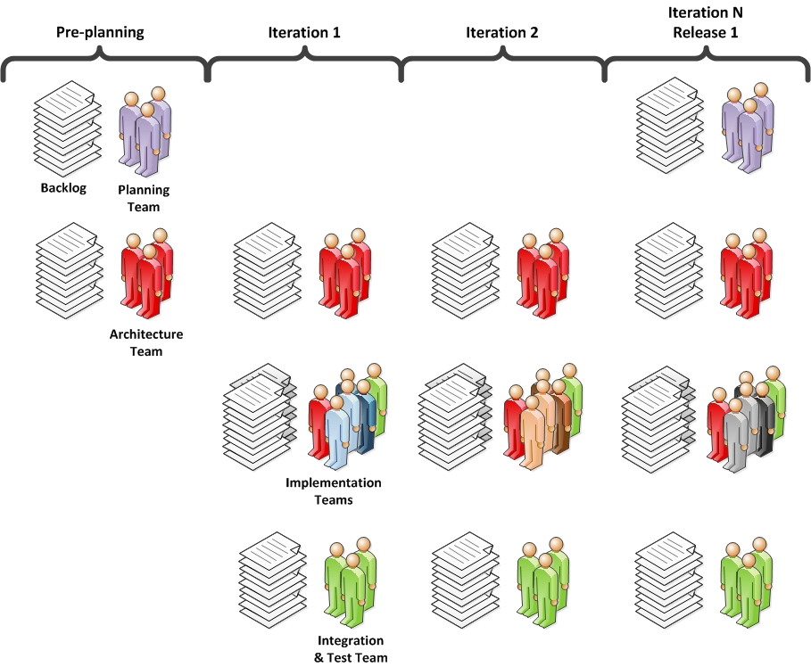
Agile SE Framework
Potentially Deliverable
Product
The Role of Systems Engineering in Large Scale Agile Projects, July 2014 Insight, Phyllis Marbach, Larri Rosser, Gundars Osvalds, David Lempia,

Slide 5
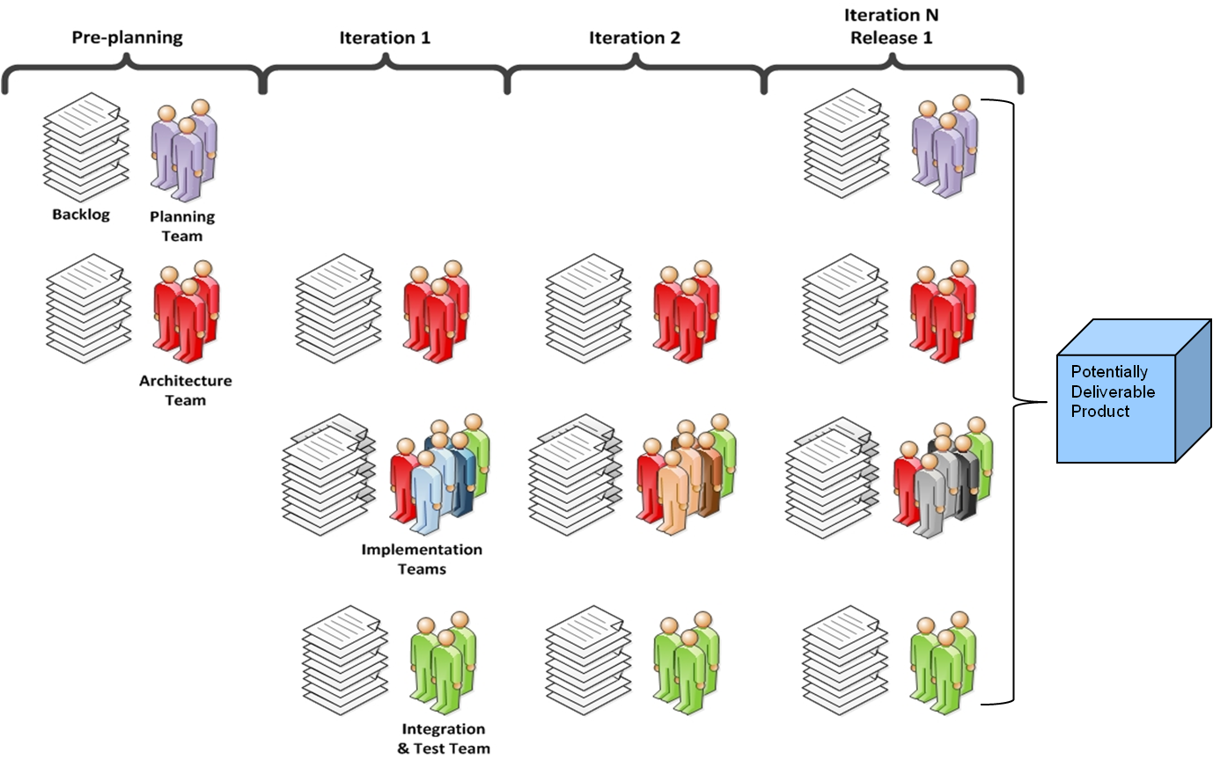
Five Levels of Planning
Vision
Roadmap
Release Planning
Iteration Planning
Daily Scrums
5

Slide 6
1. Our highest priority is to satisfy the customer through early and continuous delivery of valuable software [Beck 2001]
Potentially Deliverable
Product
Our highest priority is to First satisfy the customer stakeholder(s) through early and continuous delivery of valuable capabilities software [Marbach 2015]

Slide 7
2. Welcome changing requirements, even late in development. Agile processes harness change for the customer’s competitive advantage. [Beck 2001]
Welcome changing Plan for evolving requirements, and retain as much flexibility as is valuable throughout even late in development Agile processes harness especially when change leads to a for the customer’s competitive advantage. [Marbach 2015]

Slide 8
3. Deliver working software frequently, from a couple of weeks to a couple of months, with a preference to the shorter timescale. [Beck 2001]
Deliver working capabilities software frequently, from a couple of weeks to a couple of months, with a preference to the shorter timescale. [Marbach 2015]

Slide 9
4. Business people and developers must work together daily throughout the project. [Beck 2001]
Business personnel, customers or their advocates, and implementers people and developers must work together daily throughout the project. [Marbach 2015]

Slide 10
5. Build projects around motivated individuals. Give them the environment and support they need, and trust them to get the job done. [Beck 2001]
No changes [Marbach 2015]

Slide 11
6. The most efficient and effective method of conveying information to and within a delivery team is face-to-face conversation. [Beck 2001]
The most efficient and effective method of conveying information to and within a delivery team is personal face-to-face conversation. [Marbach 2015]

Slide 12
7. Working software is the primary measure of progress. [Beck 2001]
Working capabilities are software is the primary measure of progress. [Marbach 2015]

Slide 13
8. Agile processes promote sustainable development. The sponsors, developers, and users should be able to maintain a constant pace indefinitely. [Beck 2001]
Agile processes promote sustainable delivery development. The sponsors, developers, and users should be engaged and able to maintain a constant pace to the project completion indefinitely. [Marbach 2015]

Slide 14
9. Continuous attention to technical excellence and good design enhances agility. [Beck 2001]
No change. [Marbach 2015]

Slide 15
10. Simplicity “the art of maximizing the amount of work not done” is essential. [Beck 2001]
Simplicity “the art of maximizing the amount of work not done” is essential, especially within the implementation team. A truly agile development project does not force artifical reporting and process requirements on the implementation team. [Marbach 2015]

Slide 16
11. The best architectures, requirements, and designs emerge from self-organizing teams. [Beck 2001]
The best architectures, requirements, and designs emerge from self-organizing teams, based on a minimal set of guiding principles. [Marbach 2015]

Slide 17
12. At regular intervals, the team reflects on how to become more effective, then tunes and adjusts its behavior accordingly. [Beck 2001]
No change. [Marbach 2015]
April 2015

Slide 18
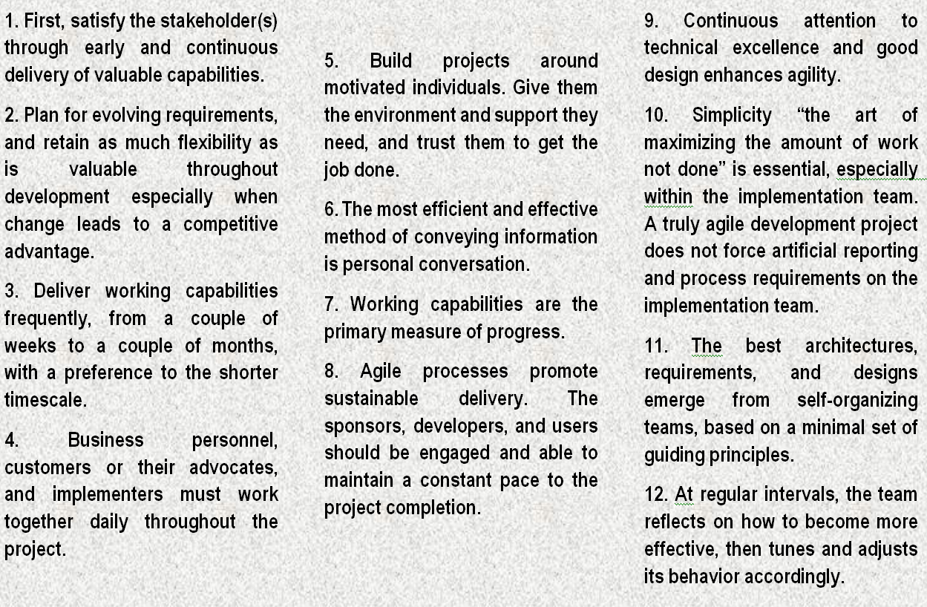
Principles for Agile Development

Slide 19
Principles for Agile Development
Provide a Foundation for Working Together
Re-enforce the five scrum values
Commit to the goal
Focus on the work that has been committed to
Respect each other
Openness with communication
Courage to commit, to focus, to be open and expect respect.

Slide 20
