Slide 1
An Integrated Model-Based Approach to System Safety and Aircraft System Architecture Development
Eric Villhauer – Systems Engineer
Brian Jenkins – System Safety Engineer
General Atomics Aeronautical Systems

Slide 2
Outline
Introduction
Standards Dependencies
Safety View
Functional Hazard Assessment (FHA) Example
  Logical behavior – “Control Aircraft Pitch” activity
  “Control Aircraft Pitch” FHA
  “Control Aircraft Pitch” Fault Tree Analysis (FTA)
Questions
References

Slide 3
Introduction
History
  Industry standards for aircraft development require consideration of System Safety objectives during all phases of System Architecture development and implementation
  Tools available to Systems Engineers and Software Engineers to model architecture currently don’t address concerns of the System Safety Engineering discipline
Objectives
  Ensure that safety objectives are considered during system architecture
  model development
  Maintain required organizational independence between System Safety and the domains with which they interface
Approach
  Use OMG SysML™ to integrate the system safety analysis methods defined in SAE ARP 4761 “Guidelines and Methods for Conducting the Safety Assessment Process on Civil Airborne Systems and Equipment” into a System Architecture model in accordance with SAE ARP4754 “Certification Considerations for Highly-Integrated or Complex Aircraft Systems”

Slide 4
Standards Dependencies

Slide 5
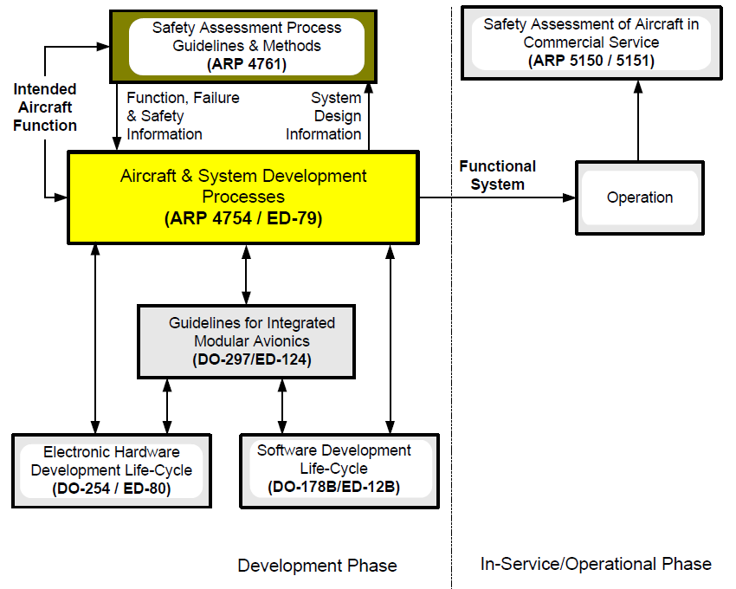
Architecture Development, System Safety, and Design Assurance Dependencies
SAE ARP 4754A FIGURE 1
GUIDELINE DOCUMENTS COVERING DEVELOPMENT
AND IN-SERVICE/OPERATIONAL PHASES

Slide 6
Safety View

Slide 7
Model-Based Safety Analysis
(MBSA)
Objectives
  Identify, classify, and mitigate safety hazard risks during
  system life-cycle
  Provide Safety Requirements to control hazard risk
  Integrate into Model-Based Systems Engineering (MBSE) process
Concerns
  Safety hazard risk identification, classification, and reduction through mitigation
  Validation and verification of safety hazard risk mitigations
  Safety hazard risk acceptance
Analysis Methods
  Functional Hazard Assessment (FHA)
  Fault Tree Analysis (FTA)
  Failure Modes and Effects Analysis (FMEA)

Slide 8
Safety Viewpoint Purpose
Provide safety requirements for system and subsystem specifications
Monitor safety throughout product life cycle
Use safety assessment to justify safety risk characterization

Slide 9
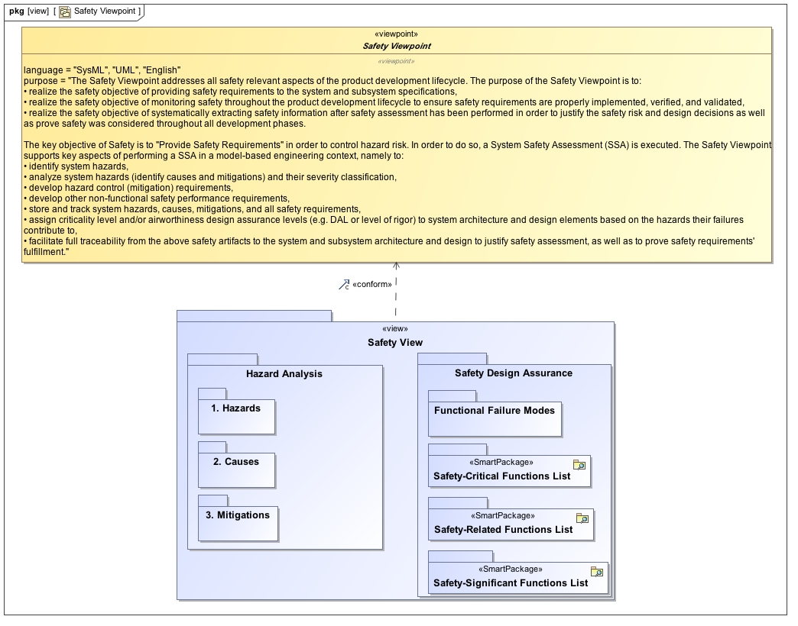
Safety Viewpoint
Safety View conforms to Safety Viewpoint

Slide 10
Safety Profile Requirements
The Safety Profile must
  Be suitable for use within a UML or SysML model
  Conform to an SAE ARP 4761 approach with provision for MIL-STD-882

Slide 11
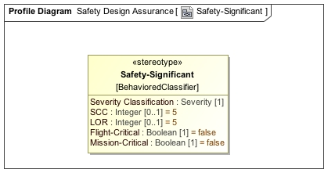
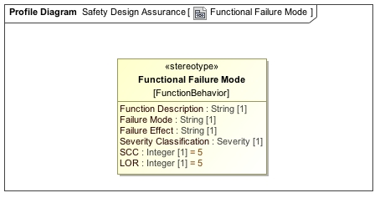
Safety UML Profile
<<Safety-Significant>>
  Indicates the element has a hazard severity
  consequence due to one or more associated
  Functional Failure Modes determined by FHA
<<Functional Failure Mode>>
  The inability of a function to perform as it is intended
  Has one or more failure effects on the system in which
  a hazard severity classification is determined
<<Manifests Failure>>
  A relation to associate a <<Safety-Significant>> functional element to its
  <<Functional Failure Mode>> elements

Slide 12
FHA Example

Slide 13
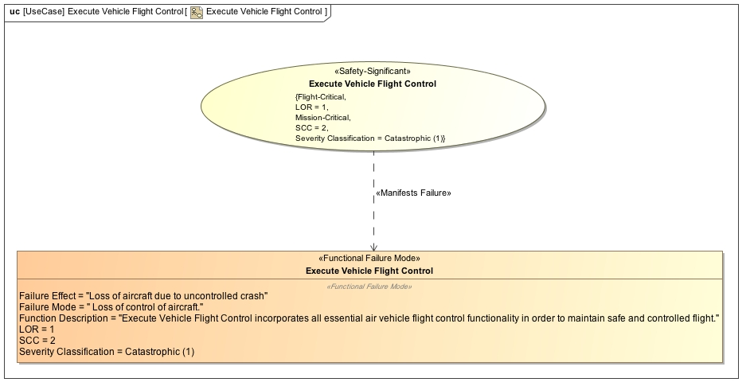
Use Case View
Aircraft level Use Case is first assessed for top-level Failure Conditions

Slide 14
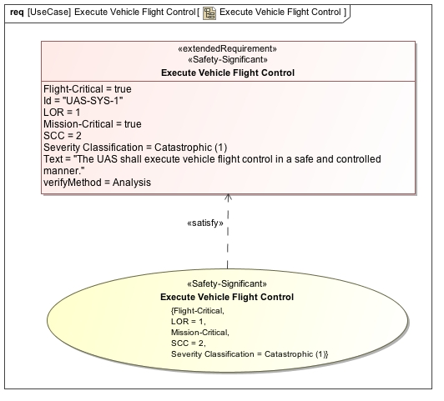
Top Level Safety Requirements
<<refine>>
Top level safety requirements tend to be difficult to measure
Use cases can provide context to system conformance to top level safety requirements

Slide 15
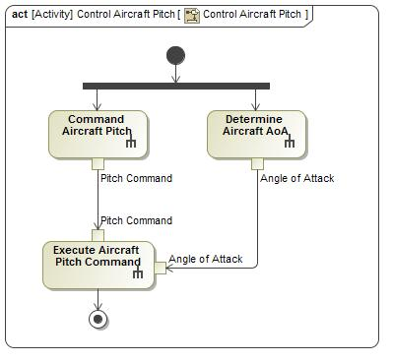
Control Aircraft Pitch – Logical Behavior
Aircraft Use Case is decomposed into Logical Views for each system function (MBSE process)
Example shown is a conceptual aircraft pitch controller that does not reflect actual design
Safety criticality of each activity will determine overall Level of Rigor / Functional Development Assurance Level (FDAL) for the
“Control Aircraft Pitch” function

Slide 16
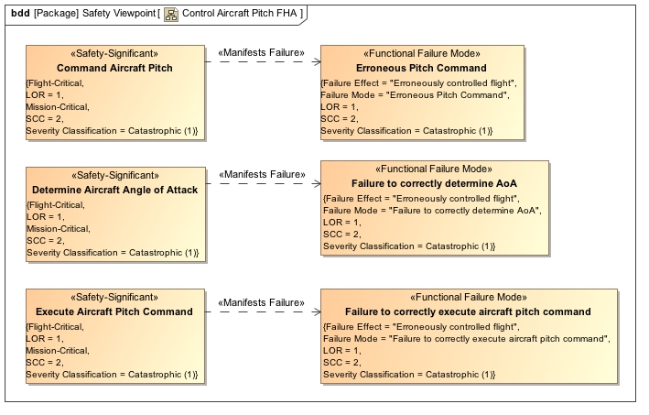
Control Aircraft Pitch –
Aircraft Functional Hazard Assessment
Functional Failure Modes
  Safety analysis is performed to determine effects, severity and likelihood of each failure mode
Manifests Failure
  Directed association that provides safety attributes
  Drives development assurance activities to be executed
  IAW ARP4754 (System Level) and
  DO-178 / DO-254 (SW / HW Item Level)

Slide 17
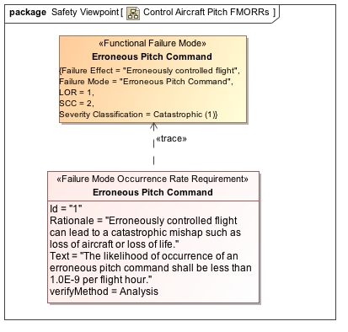
Safety Requirement Derivation
Safety requirements derived from severity classification of functional failure modes

Slide 18
Control Aircraft Pitch –
Aircraft Fault Tree Analysis
Fault Tree Analysis
  Functional Failure modes become events (top level causal factors) in Fault Tree Analysis
  Shows context and causal chain to top-level system hazards
  Fully traceable to architecture model (“safety view”)
  Mitigations identified from FMEA once full causal tree built

Slide 19

Questions

Slide 20
References

Slide 21
References
Non-Government Standards Documents
Document Number | Reference Document Title | Date | Source
SAE ARP 4761 | Guidelines and Methods for Conducting the Safety Assessment Process on Civil Airborne Systems and Equipment | 12/01/1996 | SAE
SAE ARP 4754A | Certification Considerations for Highly-Integrated or Complex Aircraft Systems | 12/21/2010 | SAE
OMG SysML™ | OMG Systems Modeling Language, Version 1.2 | 6/01/2010 | OMG
RTCA DO-178C | Software Considerations in Airborne Systems and Equipment Certification | 12/13/2011 | RTCA
RTCA DO-254A | Design Assurance Guidance for Airborne Electronic Hardware | 4/19/2000 | RTCA
OMG UML™ | OMG Unified Modeling Language Superstructure | 8/06/2011 | OMG

