Slide 1
Interoperability and System-of-Systems Engineering in Unmanned Aircraft Systems
22nd Annual INCOSE Region II
Fall Mini-Conference
2017 December 02
Richard Bryson
Northrop Grumman
Systems Engineer Architect - Interoperability
Approved for Public Release: NG17-2172, 11/20/17

Slide 2
Outline
Bio
Interoperability Definitions
How does it relate to System-of-Systems engineering?
What does an Interoperability Engineer do…and when?
Best integration approach: Top-down or Bottom-up?
Interoperability Standards
The EICD
Some Good Examples of Bad Interop Jobs
Summary
Approved for Public Release: NG17-2172, 11/20/17

Slide 3







Bio
BS in Math, Univ of Redlands 1978 – my passion, but what am I going to do with this degree?
  <<crickets>>
MS in Computer Science, USC 1982 – a more practical education
Work timeline:
1978 1980 1982 1984 1986 1988 1990 1992 1994 1996 1998 2000 2002 2004 2006 2008 2010 2012 2014 2016 2018
Software Development Methodologies, Software Management
SE Manager, SE Architect – Interop for UAVs and BMC2 GS
Data Structures, Software Development Methodologies,
MILSTAR, Telecom, Range Systems, Port Security, UAVs
gde systems inc
SWE, PM, SE for NGA contracts
Simpact
Associates, Inc.
SW Project Manager for Automatic Voice Response systems
Ada Systems Development Corp (ASDC): Instructor
Integrated CNI & EW SWE, SW PM, budding SE
JTIDS/PLRS SWE
1978 1980 1982 1984 1986 1988 1990 1992 1994 1996 1998 2000 2002 2004 2006 2008 2010 2012 2014 2016 2018
Hmmm…Did most of these companies disappear because Bryson worked for them?
Approved for Public Release: NG17-2172, 11/20/17

Slide 4
A Typical Unmanned Aircraft System (UAS) of Systems (SoS) Interface Diagram: Many Interfaces!
UAV Sensor
EO/IR/RADAR
UAV
Ground
Segment
NITF Frames
NITF Frames
Scene Tie-Up
MOC Target Deck
UAV Control Center
JTAAC
PED Front end
with CIP
Frames
NITF Mosaic
MOC Target Deck
JTAAC ATC
JTAAC
Mosaicker
MOC, IMS & Screener
ATC Cues
JTAAC
Operator
JPEG Mosaic
Exploiter
Exploited Target
Cues
IPL
Chat
Rooms
Web
Portal
Mosaic + Cue
Web Page
Mosaic
Web Page
Web Access
Web Access
End-users
(Mosaics +cues)
End-users
(Mosaics only)
Everything should be made as simple as possible, but not simpler. – A. Einstein
Approved for Public Release: NG17-2172, 11/20/17

Slide 5
Net-Centricity
Net-centric (NC)
  (Wikipedia) Net-centric refers to participating as a part of a continuously-evolving, complex community of people, devices, information and services interconnected by a communications network to achieve optimal benefit of resources and better synchronization of events and their consequences.
You say net-centric I say net-ready (NR)
  It’s the same thing: NR is defined in terms of NC
The NR Key Performance Parameter (KPP)
  (Wikipedia) The NR KPP identifies operational, net-centric requirements in terms of threshold and objective values for Measures of Effectivity (MOE) / Measures of Performance (MOP). The NR KPP covers all communication, computing, and EM spectrum requirements involving information elements among producer, sender, receiver, and consumer.
  i.e., What a program office requires in terms of effectively integrating network-based connectivity into a system
Net-centricity helps produce more-interoperable systems
Approved for Public Release: NG17-2172, 11/20/17

Slide 6


What isn’t Interoperability?
Does NC guarantee Interoperability?
  No. One can have two net-centric systems or components that don’t interoperate well at all
    Different networks, different protocols, different message sets, badly programmed behavior
    The system in the previous graphic was net-centric – the connections in the yellow box were all networks
    But it is STILL striving to become fully interoperable 10 years after initial field testing
Are all Interoperable systems NC?
  No. There are plenty of non-NC systems that do interoperate
  Including all those that pre-dated networks
To whom am I speaking?
No thanks; just had an orange.
New RAZR?
Release the hounds
The SEs are coming! The SEs are coming!
Net-centricity is neither necessary nor sufficient to ensure Interoperability…but it helps
Approved for Public Release: NG17-2172, 11/20/17

Slide 7
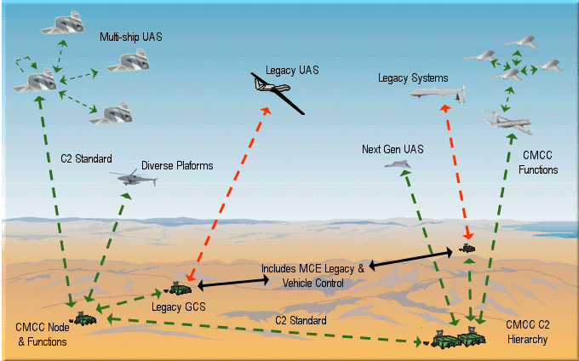
What, then, is Interoperability?
Interoperability is, in most basic terms
  The well-defined and correctly used set of all external interfaces in a system
    Connections e.g. networks
    Protocols
    Data Flows
    Expected/documented behavior: When I send this, what happens? What do I get back?
Having most connections be NC is good, but neither necessary nor sufficient
Using MIL or industry standards is good, but neither necessary nor sufficient
The physical & message interface itself is only the starting point
  It’s not sufficient to just be able to send data each way
  Must process it properly
Ref: UCI website @ https://www.vdl.afrl.af.mil/programs/uci/about.php
An OV-1 Diagram (high-level System Connectivity diagram) for a notional multi-aircraft battle management system
Some systems (of systems) are incredibly complex so full interoperability is both difficult and absolutely essential
Repeat after me: Do not drop the bomb on the nursery school!
Interoperability is a simple concept, essential to achieve, difficult to well-define
Approved for Public Release: NG17-2172, 11/20/17

Slide 8
How Does Interoperability Relate to SoS?
System of Systems (SoS) means a collaborative set of related systems
  Each individual system has its own contract, spec, development cycle, etc.
  e.g., each system in the diagram is a separately contracted complex system with its own segments, subsystems, and components
  But when these systems need to collaborate, or interoperate, it’s a system of systems
  Sometimes called an enterprise, but that term is overloaded, too
But even individual systems must have interoperable components
It’s a matter of scale and context
System
System
System
System
System
System
System
System
One man’s SoS is another woman’s system is another person’s subsystem
Approved for Public Release: NG17-2172, 11/20/17

Slide 9
When Do Interoperability Engineers Engage in a System’s or SoS’s Development?
Throughout the process
  Before the beginning
    Studies, prototypes, proposals,…
  At the beginning
    Interop rqmts in spec, arch design, build-to External ICDs (EICD)
  In the middle
    Develop test-to EICDs, interop test plans for I&T, FAT, SAT, DT, FT, OT
  At the end
    Lab test, DT, OT, as-built EICDs
  After the end
    DT, OT, O&M/Sustainment, ECPs
  And of course those administrivia tasks that permeate the development cycle
    Risks, schedules, briefings, etc.
The later you engage as an Interop Engineer, the harder your job will be
  Rework abounds!
  Engage as soon as possible and start solving the interop problems before they become problems
Note the presence of the EICD – it’s importance cannot be overstated.
(More on EICD later)
SoS/Interop Engineers play a vital role(s) throughout the developmental cycle
Approved for Public Release: NG17-2172, 11/20/17

Slide 10
Top-down or Bottom-up Development?
Answer: Outside-in!
  FIRST define the external interfaces around the black box
    Or they could be defined already by the external connections
    We can hope they are standard interconnects
  THEN open up the black box (the system under development) and build the components inside to meet the required external interfaces
Consider Your Home Entertainment System…
To achieve the best interoperability, always start design from the outside-in
Approved for Public Release: NG17-2172, 11/20/17

Slide 11
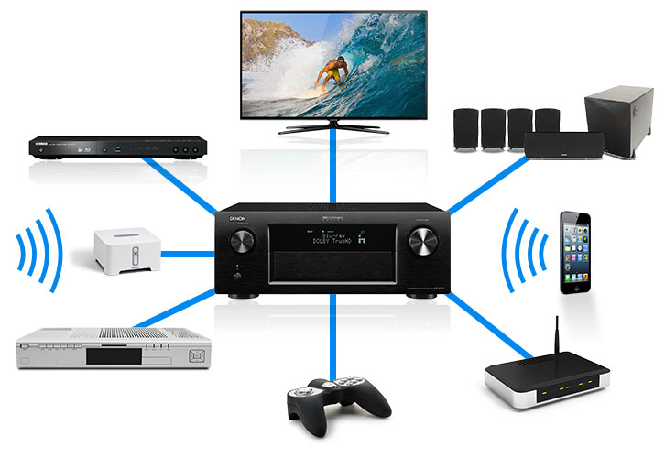
A normal-world example of outside-in integration
Unless you have an all-in-one box like an iPod or Bose Wave, you need to integrate the components together
Need standard interconnections to avoid, e.g.:
  soldering wires from the inside of one component to the inside of another
  mismatched impedance that will blow your speakers
  incompatible ports, cables, connectors
But want options on the interconnections to select highest fidelity for budget
  $1/yard standard cable?
  or $100/foot stereophile cable?
And good manuals
And online training if necessary
etc.
If designing the integrated amp above, best to start from the outside, with the standardized connections, and then work up the design of the inside of the amp.
If start inside (top-down or bottom-up) chance of meeting the standards is near nil.
Not so different from what we need for the SoSs we deal with in our work lives
Approved for Public Release: NG17-2172, 11/20/17

Slide 12
Interoperability-Related Standards
So you say you need a “standard”? Here, have a dozen or so!
Std | Org | <2005 | 2006 | 2007 | 2008 | 2009 | 2010 | 2011 | 2012 | 2013 | 2014 | 2015 | 2016 | 2017
4586 | NATO | North Atlantic Treaty Organization – Standardization Agreement (STANAG) 4586
UCI | USAF |  | COS |  | UCI – UAS C2 Control Initiative |  |  |  |  |  |  |  |  | UCI*
IOP | Army |  | IOP – Interoperability Profile
UCS | OSD |  |  |  |  | UCS – UAS Control Segment Architecture
OMS | USAF |  |  |  |  |  | OMS – Open Mission Systems
FACE | Navy |  |  |  |  |  | Future Airborne Capability Environment
NIOP | Navy |  |  |  |  |  |  | Navy Inter-Operability Profile
CoT | Mitre | CoT – Cursor on Target
SOA | industry | Service-Oriented Architecture (not a standard, but a design approach underlying others in this table)
OSA | industry | Open Architecture/Open Systems Architecture (ditto)
ACTDF | USAF | ACRM ACTM Aircraft Tasking Data Format (ACTDF) ACTDF v3.3
T3D | USAF | Tasked Target Text Data T3D v8.0
XML | ISO | Extensible Markup Language
NITF | DoD/IC/ISO/IEC | National Imagery Transmission Format
4607 | NATO | STANAG Ground Moving Target Indicator Format (GMTIF)
* UCI Renamed “Universal C2 Interface” in 2017
  XML-based
  Provides a standard message catalog and schema for providing flight & sensor Command & Control and status among participating manned and unmanned platforms and ground stations
  Goal is to allow machine-to-machine processing, with operators on or in the loop as desired
What’s the chance any of these interop standards are mutually interoperable?
Approved for Public Release: NG17-2172, 11/20/17

Slide 13
Beyond Standards
Standards provide the starting point for interoperability, but don’t always accomplish standardization much less mutual interoperability
  RS232 (old timers!) – A standard indeed, but so many options, even for this small standard, that “RS-232-compatible” became a joke
  XML allows one to define one’s own schema with text-based tags and data, so no inherent interoperability (but enables interoperability!)
  A NITF field definition might allow a sensor to swing ±90 degrees from nadir, but your radar has hard stops at ±80 and will be damaged if slewed beyond them
  UCI schema might have Altitude as an optional field, but your ground segment requires it to be populated
  MPEG: are you using a compatible I-frame rate?
Valerie: Think it’ll work?
Miracle Max: It would take a miracle.
Standards, while indispensable, do not guarantee interoperability
Approved for Public Release: NG17-2172, 11/20/17

Slide 14
The External Interface Control Doc (EICD)
Use an external interface control document (EICD) or the like, coupled with an Memo of Understanding (MOU) between program offices directing that the EICD is ground truth
Standard XYZ Message A
Field 1 – set to 10
Field 2 – leave per std
Field 3 – leave per std
Field 4 – restrict to 5 to 15 secs
Field 5 – leave unpopulated
Field 6 – “START”, “IN WORK”, “DONE”
Option 1:
Duplicate the standard’s message and tailor the fields to meet your interface needs
Good, if tedious, when a large portion of the standard must be tailored
This is what we did for one recent program
Option 2:
Provide “delta” tables that define only those fields where you are deviating or further restricting/defining what’s in the standard
  Good when the vast amount of the standard will be used as-is
  This is what I plan to do on my current program
Message A Deltas
Field 1 – set to 10
Field 6 – “FAILED”, “DONE”
The EICD: An interchange contract between systems
Approved for Public Release: NG17-2172, 11/20/17

Slide 15
Typical EICD Content
An EICD should provide information to fully define an interface in a way to meet interoperability, including as examples:
  Textual descriptions of the interface
    including behavior
  Diagrams
    OV-1
    OV-2
    Network Diagrams
    Message Sequence Diagrams
  Message Catalog
    Direction of flow of the message from source to destination
    Protocols
    Physical connections & appliances
    etc.
  Tailoring of the standards
    Standard-optional fields that are mandatory for this interface
    Extensions (if allowed)
    Range/value restrictions beyond what the standard allows
    Expected behavior, responses
  Reference documents
    the standards used at least
  Cyber Security considerations such as
    Enclaves
    DMZs
    Compliance checklist
A good EICD tailors standards to promote interoperability
Approved for Public Release: NG17-2172, 11/20/17

Slide 16
EICD Table Fictional Example
Tables can express a lot of information compactly and accurately
  Especially when accompanied by relevant network and data flow diagrams (OV-2) and behavioral descriptions
Table 5-12: Bryson Air Vehicle (BAV) Message Flow (Notional)
Message | From | To | Connection | Type | Protocol | Class | Crypto | Notes
AV Position | Air Vehicle | AV Ground Station | UHF SATCOM | BAV XML | Custom** | Secret | KG135 | **See BAV SATCOM EICD
Position Report | AV Ground Station | BMC2 Node | SIPRNet | UCI v72 | UDP/IP | Secret | KG175
Position Report Reply | BMC2 Node | AV Ground Station | BMC2 LAN | UCI v72 | TCP/IP | Unclass | n/a
Radar Task | AV Ground Station | Air Vehicle | SIPRNet | BAV XML | TCP/IP | Secret | KG175
SAR Image | Air Vehicle | AV Ground Station | BMC2 LAN | NITF 2.1 | sftp | Unclass | KG255
Mosaicked Image | AV Ground Station | BMC2 Node | SIPRNet | NITF 2.1 | NFS | Secret | n/a
Goal: Make life as easy as possible for your readers: SWEs, SEs, PMs, Customers…
Approved for Public Release: NG17-2172, 11/20/17

Slide 17
Good Real-life Examples of Bad Interop/SoS Engineering
“Gapfiller” Situational Awareness Messages
“It’s not my problem”
Approved for Public Release: NG17-2172, 11/20/17

Slide 18
Gapfiller Situational Awareness (1 of 2)
The Originally Defined Situational Awareness (SA) Message Catalog
AV Position
Sent once/sec
Tail #
Latitude
Longitude
Altitude
Fly-to Waypoint
Nav Plan
Sent upon change
Tail #
Nav Plan ID
Waypoint #1
Latitude
Longitude
Altitude
Waypoint #n
Latitude
Longitude
Altitude
Collection Plan
Sent upon change (in whole or part)
Tail #
Task #1
Task Type
Target Location
Time to Collect
Task #m
Task Type
Target Location
Time to Collect
Collection Status
Sent upon change per Task
Tail #
Task Status =
Pending
In Process
Collected
Downlinked
Deleted
Failed
Comms Status
Sent upon change
Tail #
WB SATCOM Status
WB LOS Status
Cmd Link Status
Cmd BU Link Status
Well-defined, topic-oriented, uses periodic message only for periodic data.
As simple as possible…but no simpler
Approved for Public Release: NG17-2172, 11/20/17

Slide 19
Gapfiller Situational Awareness (2 of 2)
The “Gapfiller” SA Message Catalog
In Jan 2007, a “1-2 year gapfiller” SA message set
was defined due to budget constraints
In 2017 Gapfiller lives!
  And costs much more
It’s everything wrong you learned about data design
  Forced periodicity of non-periodic data
  Bundling of unrelated data
  Big kludge for ad hoc collects
  No indicator of Short vs Full messages
  Missing a critical key for an external user
Full Message
Sent once/min
Tail #
AV Position Section
Comms Status Section
Full Nav Plan every single time! 1000s of waypoints, every single time!
Collection Plan for time NOW forward Catches changes, but lots of repetition every single time
Collection Status for any/all tasks completed since last Full or Short message
Short Message
Sent once/sec Unless it’s time for a Full Message instead
Tail #
AV Position Section
Comms Status Section
Current Fly-to Waypoint
Collection Status For those Tasks completed since the last Full Message was sent Oh, but wait, what about Tasks added since the last Full Message? So, better add Collection Plan info for those added since then!
Collection Plan Info for Ad Hoc Tasks Added Since Last Full Message
Lesson learned: As stubborn as I am, sometimes I am not stubborn enough
Approved for Public Release: NG17-2172, 11/20/17

Slide 20
“It’s Not My Problem”
Bkgnd: The Sensor Management SW (SMS) was not interfacing correctly with the Flight Management SW (FMS)
Richard to SMS SWE: We need to get you and the FMS SWEs together to work out the problems.
SMS SWE: That’s not my job. I meet my SRS.
Richard: But the whole system needs to work or we all lose our jobs. Your SRS might need to be updated.
SMS SWE: But that’s not my problem. My SW meets my SRS.
Richard: OK, this conversation (and all others with you in the future) is over.
SMS SWE left the company soon thereafter
“Everyone should be a Systems Engineer” – but not everyone can.
Goes double for SoS/Interoperability Engineering
Approved for Public Release: NG17-2172, 11/20/17

Slide 21
A (Notional & Partial) Hierarchy of a Systems of Systems of Systems of Systems…
We’ll be back!
Skynet
(The sky’s not really the limit.)
Integrated DoD Weapons System
Joint Services ISR Enterprise
Joint Services Strike Enterprise
Increasing Power & Complexity
Air Force ISR Enterprise
Battle Management Enterprise
Unmanned Air System (UAS)
Exploitation System
Air Vehicle
AV Ground Station
BMC2 Node
One man’s system of systems might become…Skynet!
Approved for Public Release: NG17-2172, 11/20/17

Slide 22
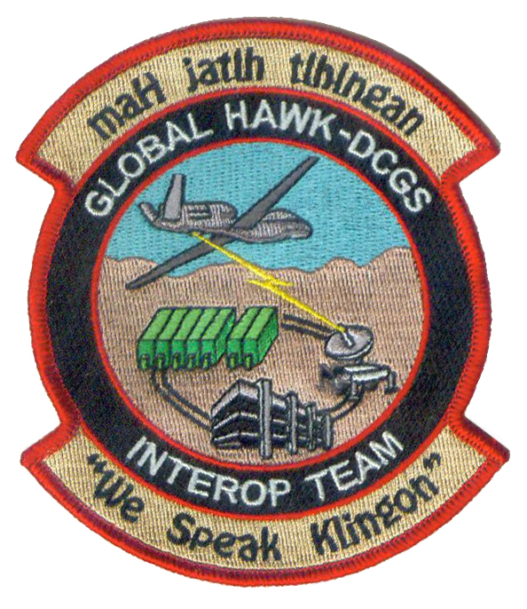
Summary
Interoperability and Net-Centricity are related, but not synonymous
Interoperability and SoS Engineering are virtually synonymous
EICDs (w/MOUs) are essential
Employ “Outside-in Development”
  Work from the external interfaces inward
As they say in Chicago: Vote Early & Often
  i.e., Get involved as early as possible to fend off as many future problems as possible
Be bold! Be stubborn!
  Don’t let Customers, PMs, SE Mgrs, other naysayers dissuade you from sticking your nose in wherever necessary
  Learn to speak and preach Interoperability
Listen to Einstein! Do keep things as simple as possible but not simpler
maH jatlh tlhIngan!
System of Systems Engineering: Think of it as evolution in action
…but YOU must intervene and provide the intelligence in the design
Approved for Public Release: NG17-2172, 11/20/17

Slide 23
Questions?

Slide 25
Backup
Approved for Public Release: NG17-2172, 11/20/17

Slide 26
Notes to Self (not part of briefing)
Briefing Release Process:
http://eprocs.northgrum.com/firstVisit.asp
Working Title: Interoperability and System-of-Systems Engineering in Unmanned Aircraft Systems
Abstract:
Evaluates several questions of interoperability and systems-of-systems engineering, including what exactly is interoperability? How does it relate to system-of-systems engineering? What is best approach to development of interoperable systems: top-down, bottom-up, or something else? Are there any interoperability standards? Then provides examples of how interoperability was infused into complex unmanned aircraft and ground control systems.
Approved for Public Release: NG17-2172, 11/20/17

