Slide 1
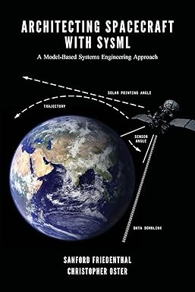
INCOSE-SD MBSE with SysML Tutorial
Modeling a Spacecraft Example
2024
Dr. James ter Veen, UCSD, jterveen@ucsd.edu
with a little help from Architecting Spacecraft with SysML,
S. Friedenthal & C. Oster
Copyright notice: Portions of this work are from the book Architecting Spacecraft with SysML, by Sanford Friedenthal and Christopher Oster, published by CreateSpace Independent Publishing Platform, Copyright 2017 Friedenthal & Oster. All rights reserved. Portions © James ter Veen, PhD Unpublished Work.

Slide 2
Schedule
8:30 Registration
9:00 Overview of SysML
9:30 Download and install SysML modeling tool (Astah)
10:00 Mission Needs –Requirements - Use Cases
12:00 Lunch
1:00 Structure, Behavior, Parametrics and Allocations
3:00 Wrap up

Slide 3
Overview
Introductions
Practicing Systems Engineers?
Systems Architects?
Managers?
Software Engineers?
Systems Modelers?
Any previous training?
SE ‘Vee’ model
Objectives?
Every element and diagram should have a purpose, an intended use and someone who needs to use it.
Agile Systems Engineering, B.P. Douglas, Morgan Kauffman, 2016
© 2024, James ter Veen PhD. Unpublished Work, SysML examples from Architecting Spacecraft with SysML © 2017 All rights reserved

Slide 4
What are we doing?
What is MBSE?
Model-centric versus Document-centric
Many types of models
What is SysML?
A graphical modeling LANGUAGE for:
specifying
analyzing
designing
verifying
maintaining complex systems
Developed by Object Management Group (OMG)
Published by International Organization for Standardization (ISO)

Slide 5
Why a Model-Centric approach?
Generate System Architecture alternatives, frame stakeholder concerns, meet system requirements and express this in a set of consistent views (IEEE 15288)
A picture is worth a thousand words

Slide 6
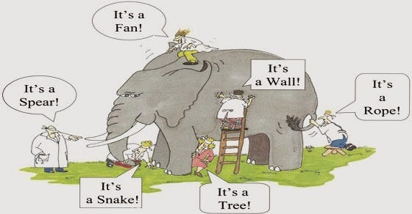
Five blind men & an elephant
https://medium.com/betterism/the-blind-men-and-the-elephant-596ec8a72a7d

Slide 7
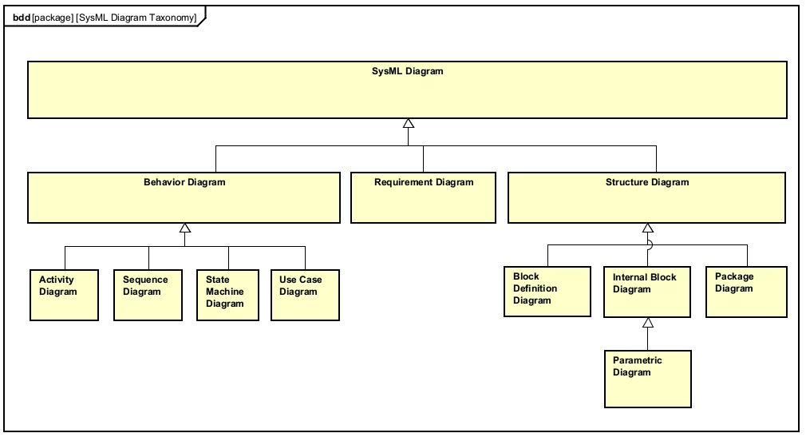
Diagrams are NOT Models!
Diagrams provide views/perspectives/graphical representations of the SysML model
https://www.omgsysml.org/what-is-sysml.htm

Slide 8
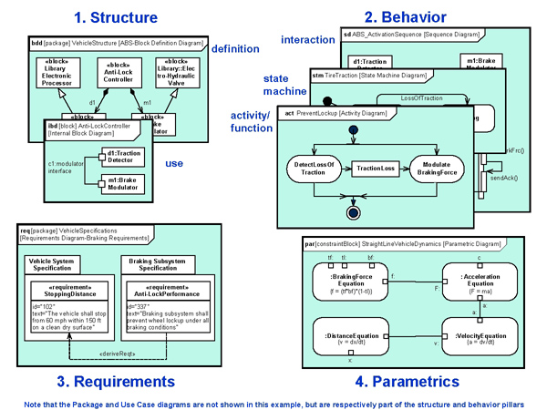
Four Pillars of SysML
https://www.omgsysml.org/what-is-sysml.htm

Slide 9
Requirements Diagrams
Mission Needs
Stakeholder needs
Text specifications with ID #s
May trace to source documents
May be derived from higher levels
Use Cases help refine requirements
Structure elements satisfy requirements
Test Cases verify requirements

Slide 10
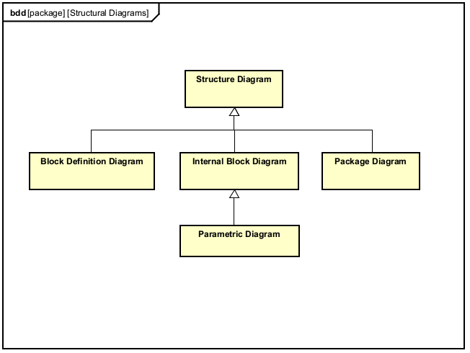
Structure Diagrams
Package
Block Definition
Internal Block
Parametric

Slide 11
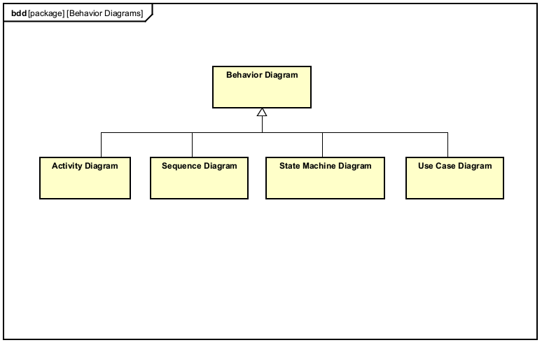
Behavior Diagrams
Activity
Sequence
State Machine
Use Case
Diagram versus Narrative

Slide 12
Fire Sat II Mission
We’ll follow the example satellite project in Architecting Spacecraft with SysML¹
You can tailor your model to a different satellite mission or just follow the example
Fire Sat II Mission Statement:
The fundamental problem to be addressed for the FireSat II mission is the damage and associated costs resulting from forest fires across the United States and Canada. The need for the FireSat II mission is to provide data that can help mitigate this damage.¹

Slide 13
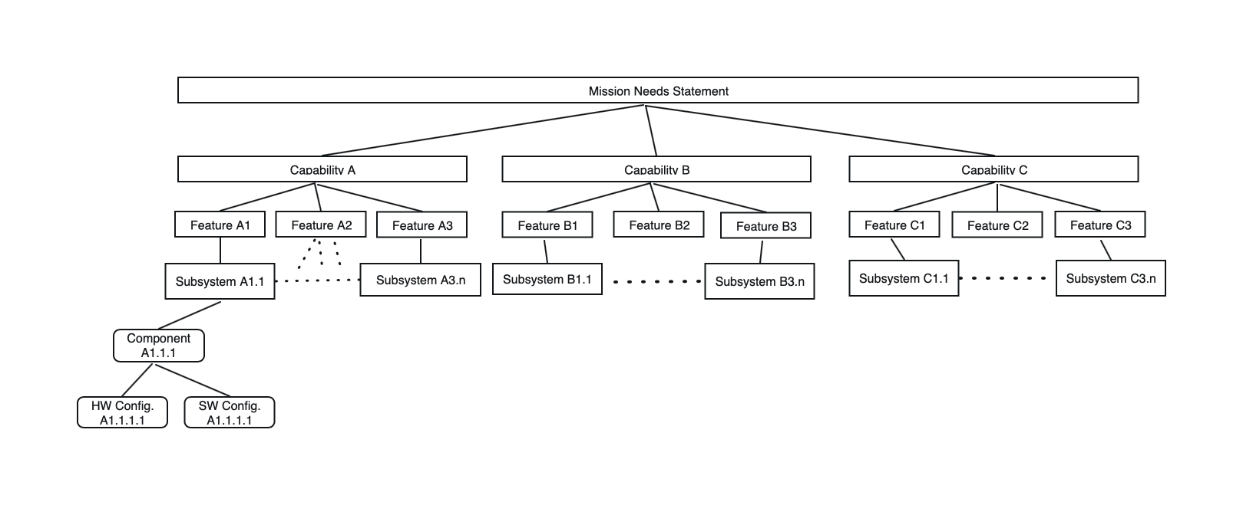
Generic Mission Needs Decomposition

Slide 14
Exercise 1 – Mission Needs
Create a Mission Statement for your satellite
Option: Use the FireSat II Mission statement (slide 12)
Focus on the purpose of your project
Think about stakeholders and their needs
Keep sentences simple, unambiguous & atomic
Focus on a scope and relevant data within that scope.
About 1 paragraph, typed so you can copy and paste it into your model

Slide 15
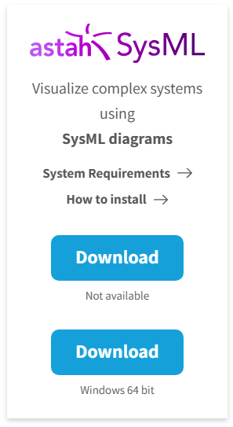
Exercise 2 - Download & Install Astah SysML
Go to https://astah.net/downloads
Select the Astah SysML download for Windows 64 bit
You’ll get a 20 day free trial
Almost all of the SysML diagrams in this presentation have been created using Astah along with the example project files

Slide 16
Exercise 3 – Model Organization (1 of 4)
Open Astah
Open the Exercise 3 Model Organization Project
Select the ‘Requirements’ package
Right-click and select Create Model
Drill down to, and select ‘Requirement’
In the Detail pane, name your new requirement ‘Mission Needs’
Paste your Mission Needs paragraph into the Text field for this Requirement

Slide 17
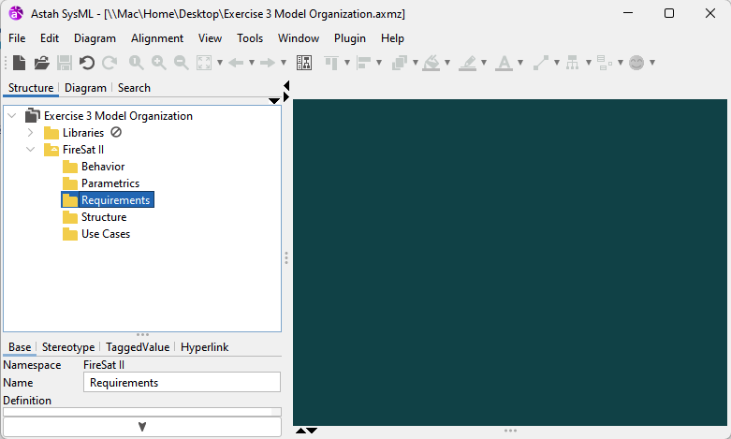
Exercise 3 (2 of 4)
Select the Requirements Package

Slide 18
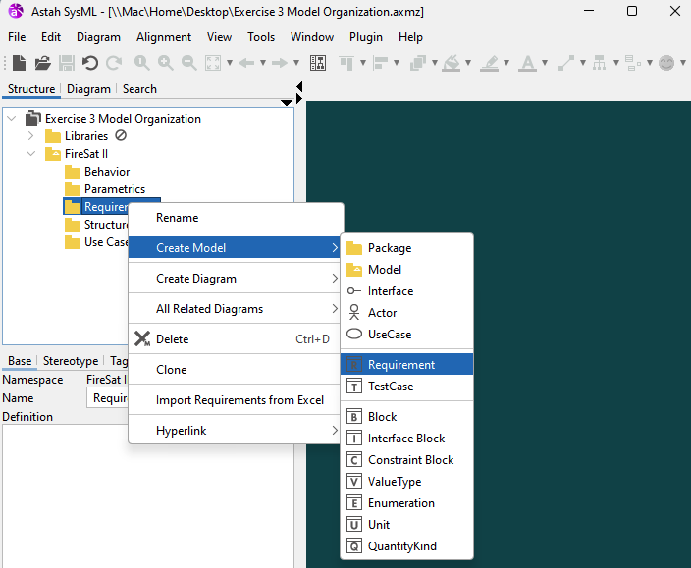
Exercise 3 (3 of 4)
Drill down & select Requirement

Slide 19
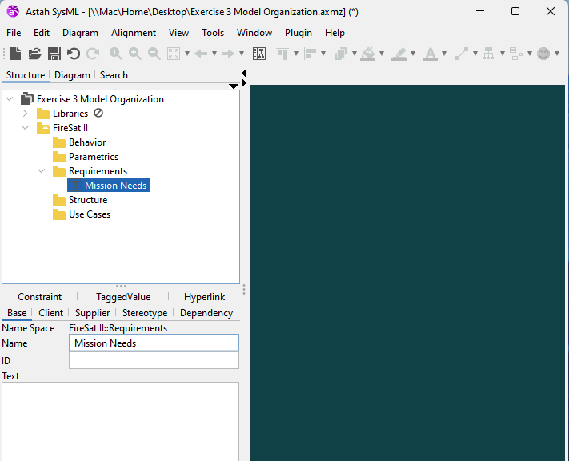
Exercise 3 (4 of 4)
Name your new requirement ‘Mission Needs’
Give your first requirement an ID #: 01
Paste your Mission Needs paragraph here

Slide 20
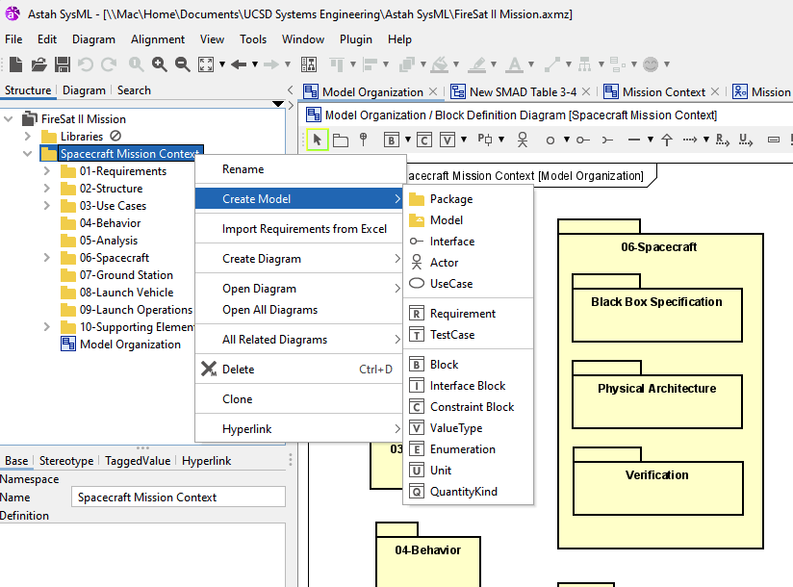
Exercise 4- Add Packages (1 of 4)

Slide 21
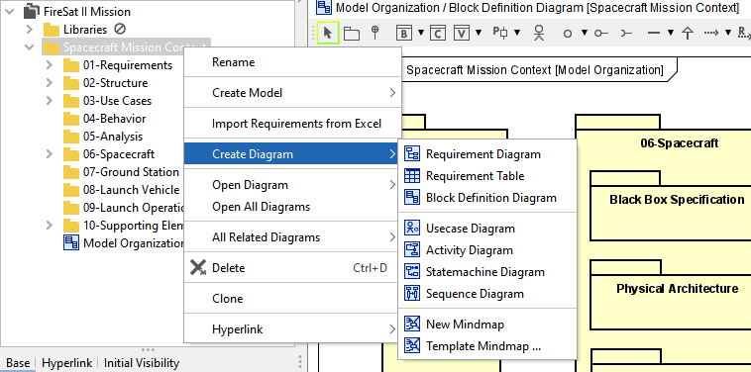
Exercise 4 Package diagram (2 of 4)
We’ll use the Block Definition Diagram type to create Package Diagrams
Package diagrams, Internal Block Diagrams and Parametric diagrams are all ‘Structure’ kind of diagrams; it’s how the modeler arranges the content that distinguishes between these in the Astah tool

Slide 22
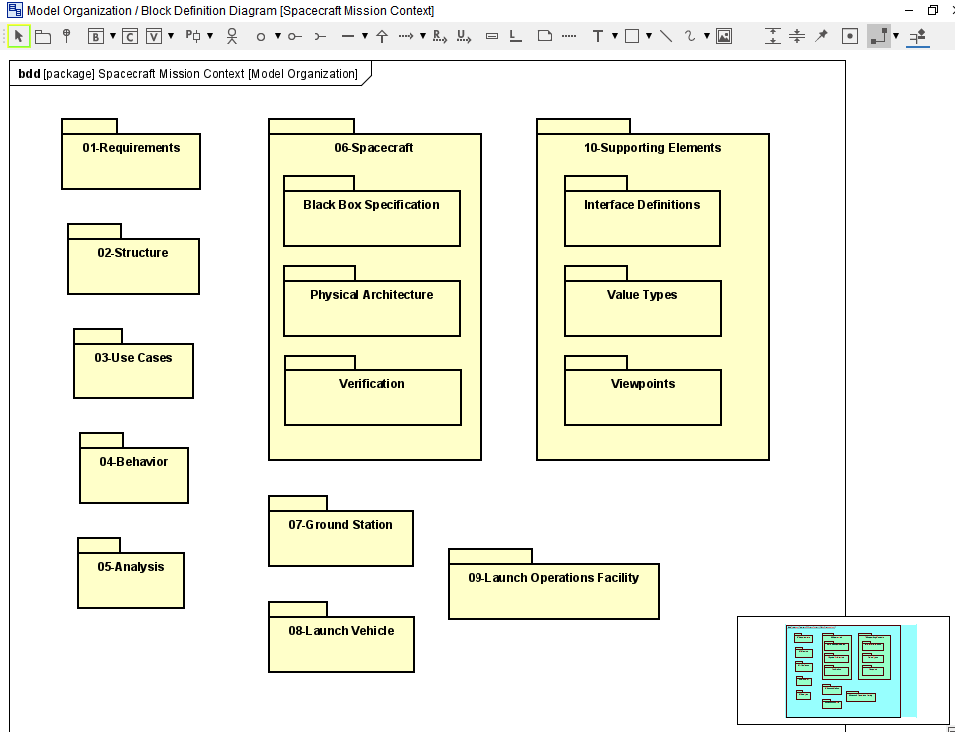
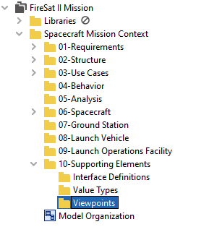
Exercise 4 – Drag & Drop (3 of 4)
Drag and drop your package elements onto the diagram

Slide 23
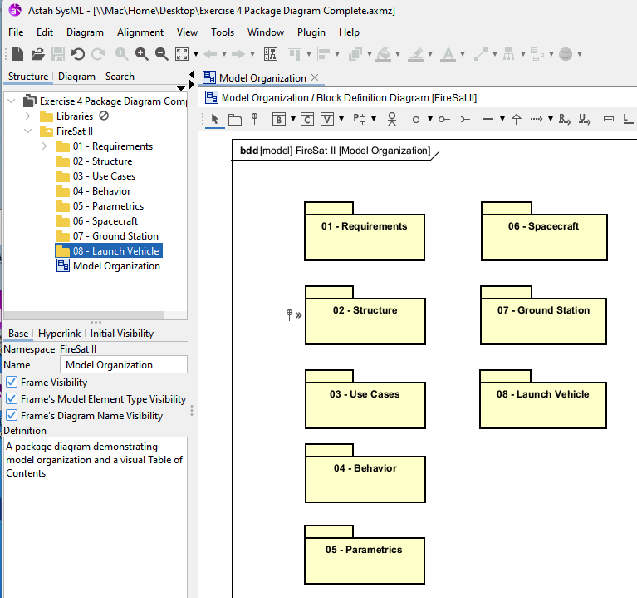
Exercise 4 – Complete (4 of 4)

Slide 24
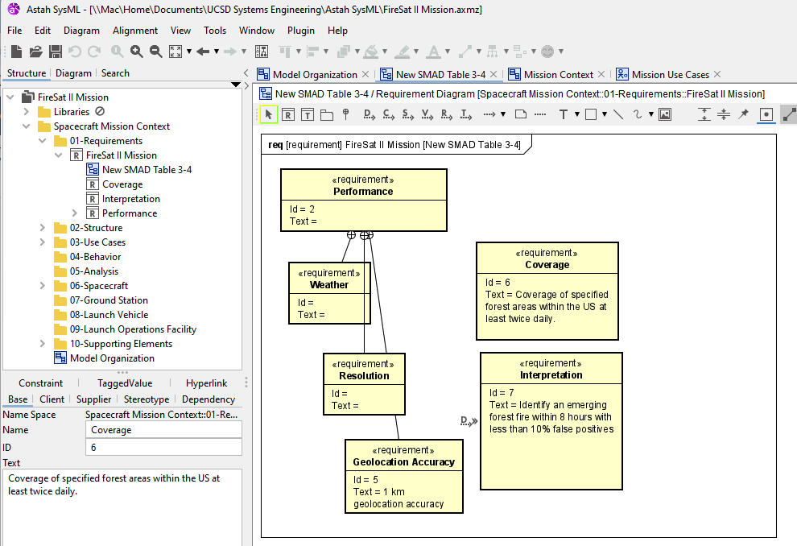
Entry of Requirements
Right-click on Requirements package
Use detail pane to add an ID number and the text
Create a Requirements
diagram
Drag and Drop them
Organize

Slide 25
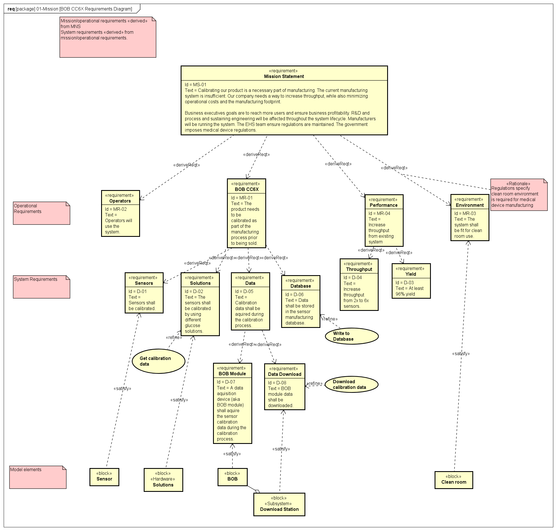
Requirements Organization
Mission Requirements
Operational Requirements
<<deriveReqt>>
System Requirements
<<deriveReqt>>
Model Elements
<<satisfy>> <<refine>>

Slide 26
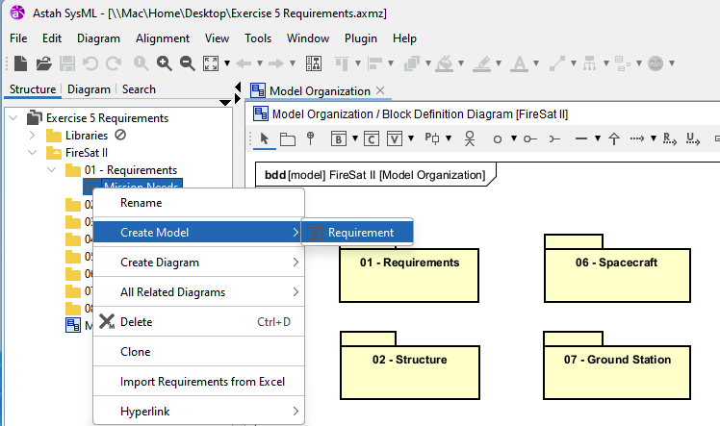
Exercise 5 Add Requirements
1) Right-click on your Mission Needs Requirement
2) From the context menu add a sub-requirement

Slide 27
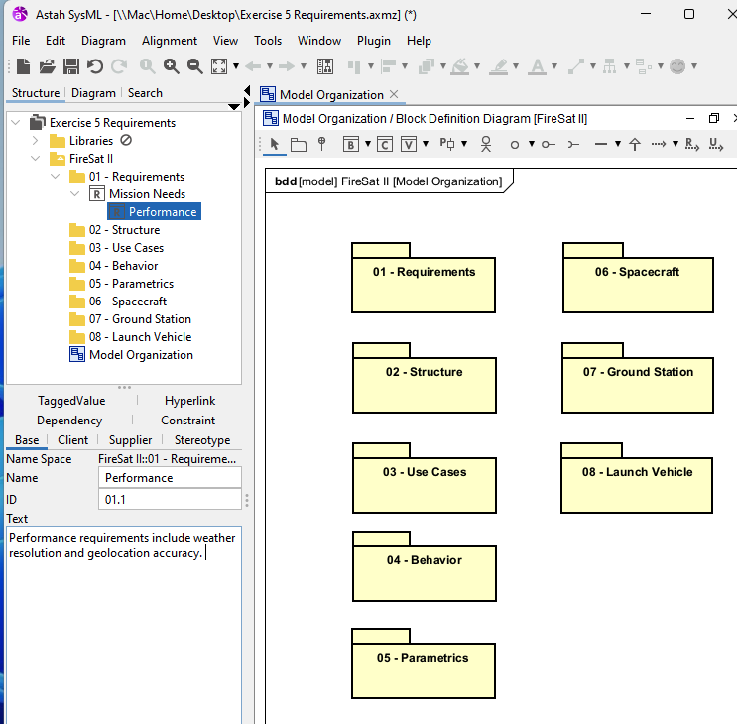
Exercise 5 Add Requirements
3) Name it ‘Performance’
4) Set ID to ‘01.1’
5) Copy the text from the ‘FireSat II Mission Needs Statement’ MS Word document
6) Repeat for each requirement incrementing the ID numbers

Slide 28
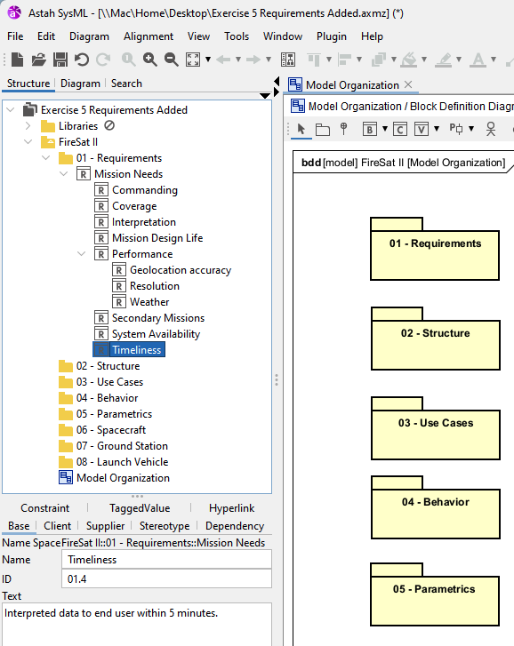
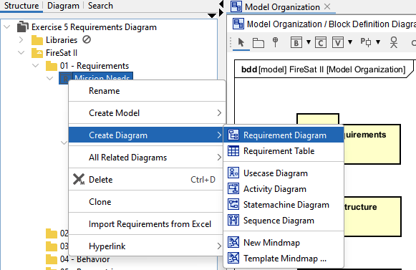
Exercise 5 – Make Requirements Diagram

Slide 29
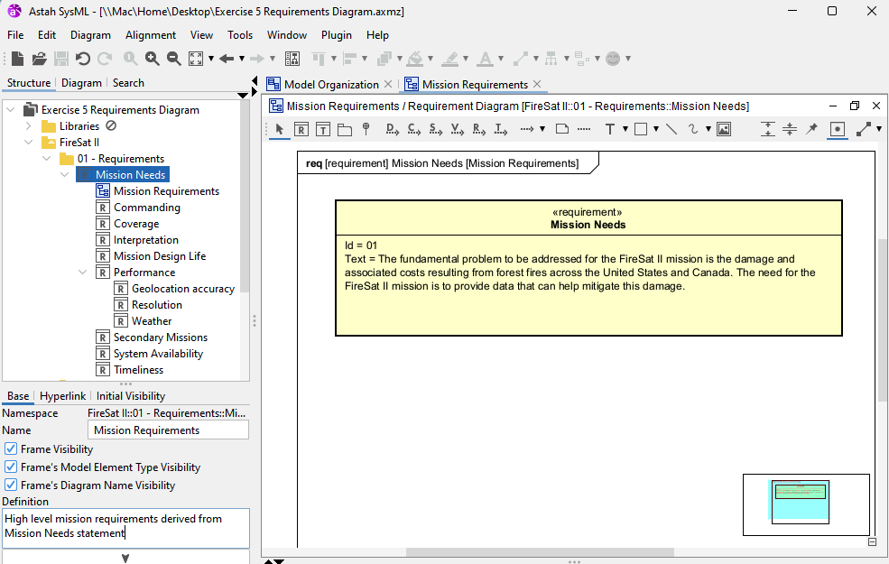
Exercise 5 – Make Requirements Diagram
Drag & drop your Mission Needs requirement onto the empty frame
Give your new diagram a name & definition

Slide 30
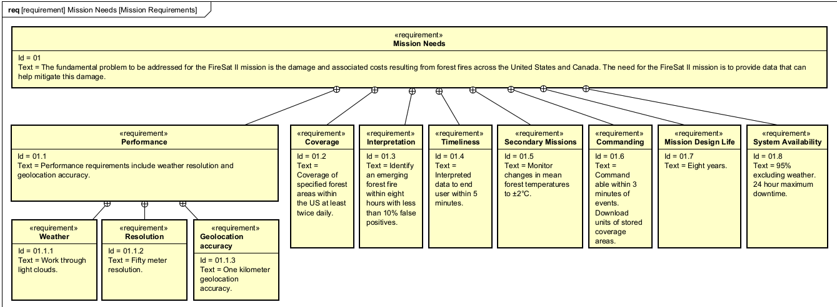
Exercise 5 – Make Requirements Diagram
Drag & Drop requirements onto the diagram. Tip: Use the Alignment menu items to adjust height, width, etc.

Slide 31
Lunch!

Slide 32
What are Use Cases?
“Use Cases are requirements (although not all requirements). Some think of requirements only as ‘the system shall do…’ function or feature lists.”
“Use Cases are text documents, not diagrams, and use case modeling is primarily an act of writing, not drawing.”
Use Case Diagrams illustrate names of use cases, actors and relationships.
Black box view of the services that a system performs in collaboration with its actors
A diagram conveys a set of use cases – verb phrases
Sometimes, actors are other systems
Use Cases: Requirements in Context, 2nd Edition, Kulak & Guiney, Addison-Wesley, 2004

Slide 33
Use Case Specification
Name – a verb phrase (verb-noun, e.g. ‘Grow Food’)
Primary actor
Secondary actor(s)
Stakeholder
Pre-conditions
Post-conditions (a.k.a. Guarantees)
Trigger
Main Success Scenario (a.k.a. Sunny Day)
Alternative branches
Each path of execution is a distinct scenario
© 2024, James ter Veen PhD. Unpublished Work, SysML examples from Architecting Spacecraft with SysML © 2017 All rights reserved

Slide 34
Fire Sat II Use Cases
Stakeholders
For FireSat II, the Forest Service is concerned about loss of life and property due to forest fires.
The fire department is concerned about their ability to put out a fire in a timely manner to prevent the loss of life and property.
The sponsor cares about the ability to satisfy the mission requirements within cost and schedule constraints.
The development contractor is concerned about establishing a feasible design to satisfy the mission requirements.
The operator is concerned about his or her ability to operate the spacecraft to achieve the mission objectives.

Slide 35
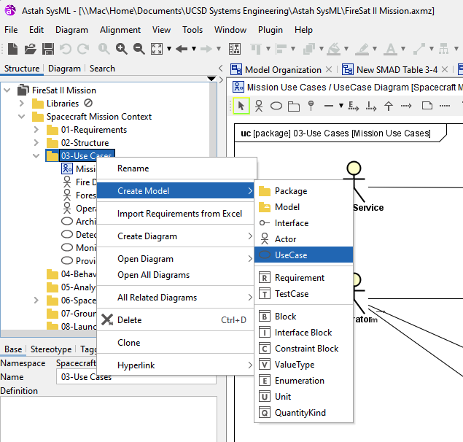
Exercise 6 - Add Use Cases
Right click on your Use Case package
Create Use case elements (cases & actors)
Add Use Case Narrative in Description field

Slide 36
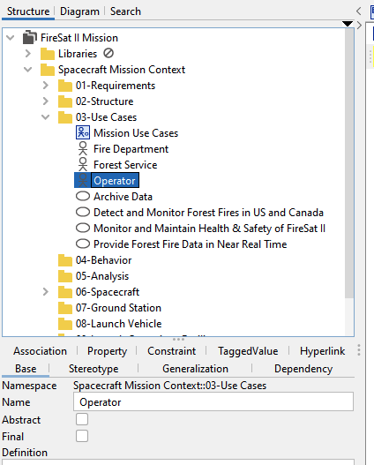
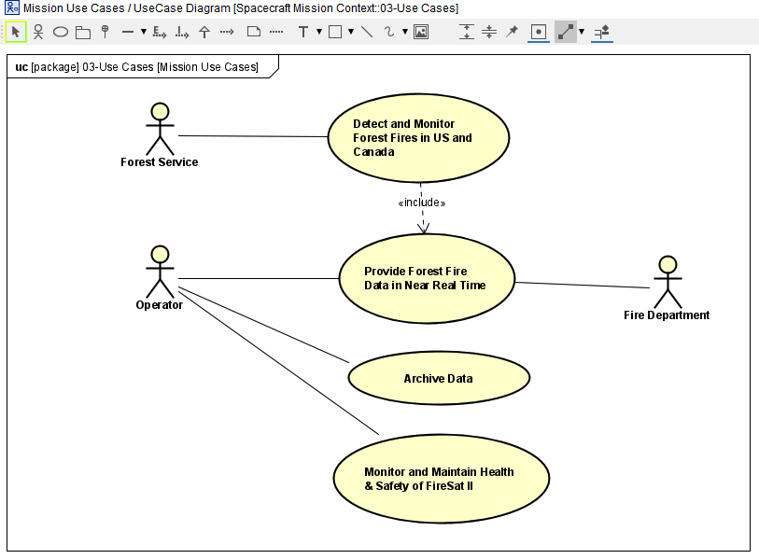
Exercise 6 - Add Use Case diagram
Right click on your Use Case package
Select ‘Create Diagram’, ‘Use Case’
Drag and drop elements onto your diagram

Slide 37
Modeling System Structure
We use Packages for Model Organization
We’ll use Block Definition diagrams to:
Define our System Context – with what externals will our system of interest interact?
Define our System Concept – what will be internal to our system of interest?
We’ll use Internal Block Diagrams to show what goes on inside of blocks; especially flows of items & data

Slide 38
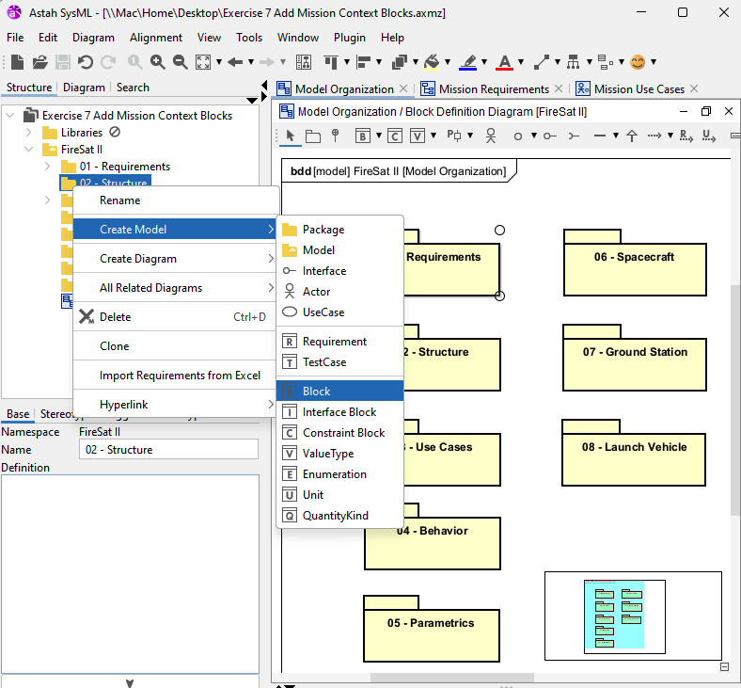
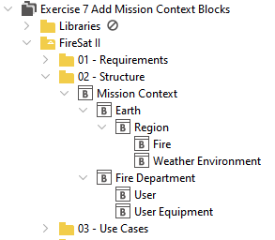
Exercise 7 – Add Mission Context

Slide 39
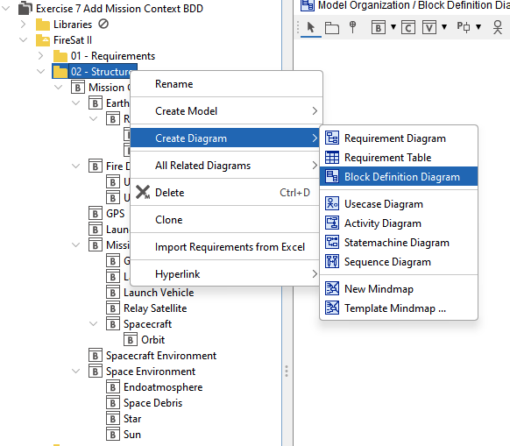
Exercise 7 – Add Mission Context BDD

Slide 40
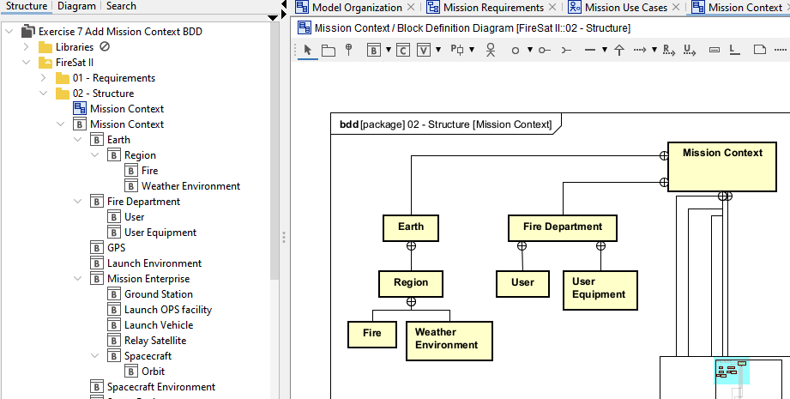
Exercise 7 – Add Mission Context BDD

Slide 41
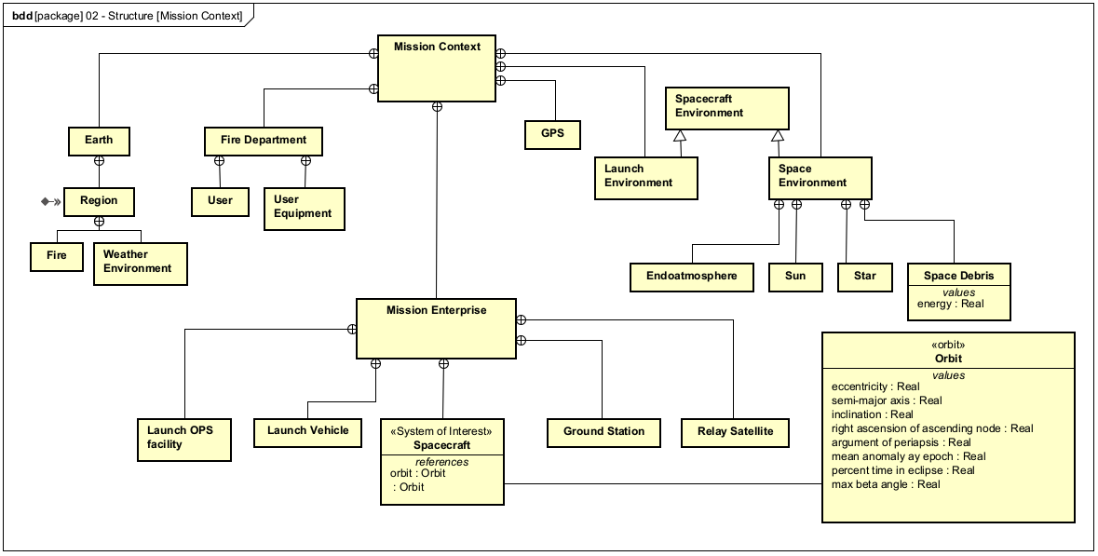
Exercise 7 - Mission Context

Slide 42
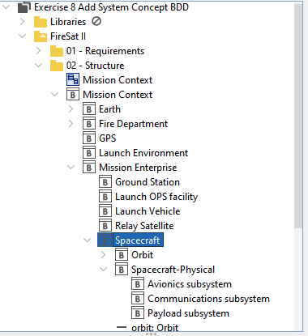
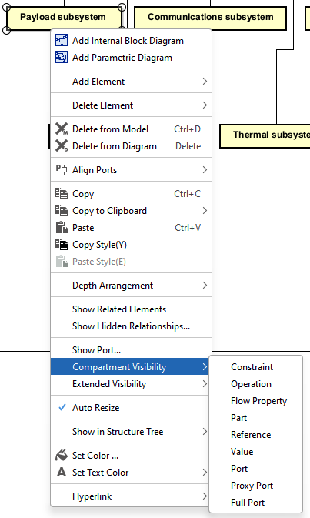
Exercise 8 – System Concept
Add Payload subsystem and add a compartment to the block

Slide 43
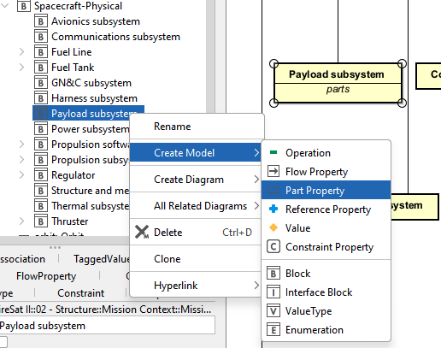
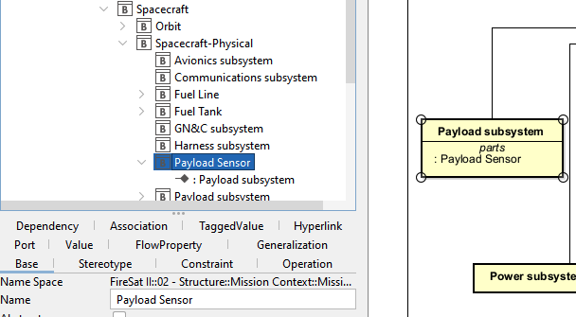
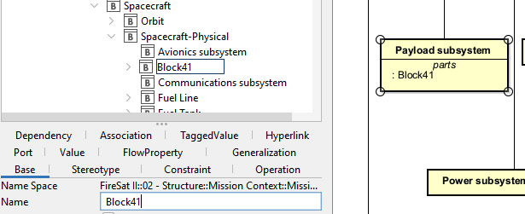
Exercise 8 – System Concept
1
3
Add a Part Property
Give it a name
See it in the block
2

Slide 44
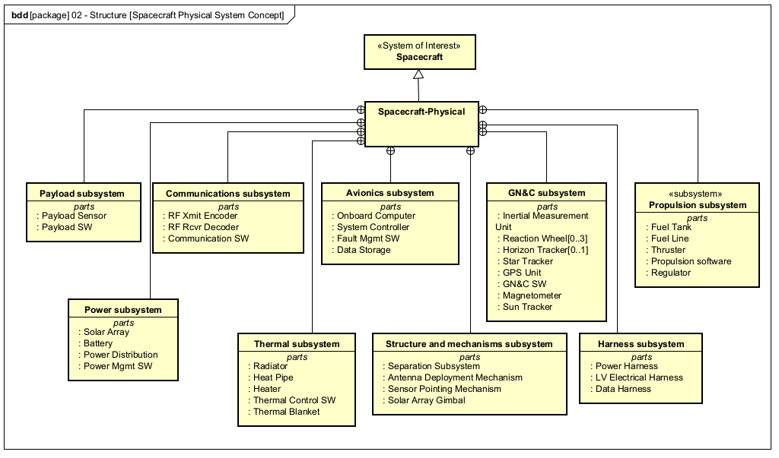
Exercise 8 System Concept Complete

Slide 45
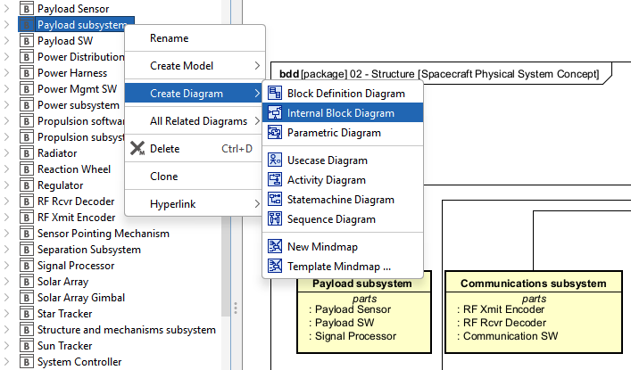
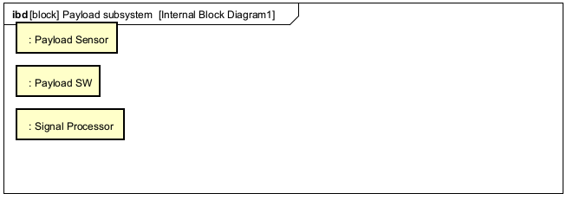
Exercise 9 Payload Subsystem IBD
Why use an IBD?
-Specify internal structure of a single block
-Display usages of blocks
-Show types of matter, energy or data that flow across connections

Slide 46
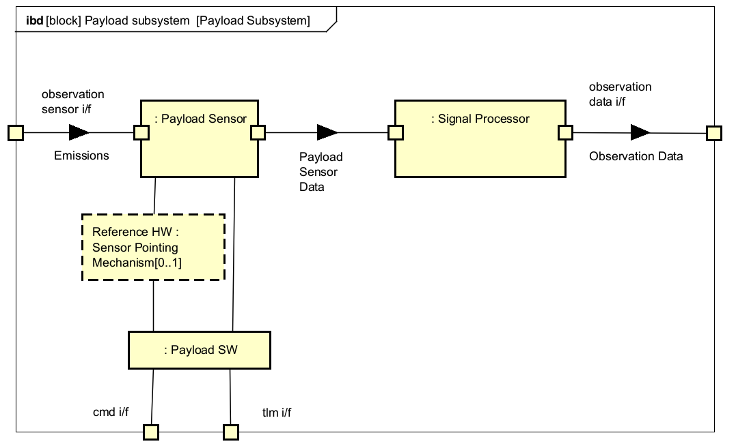
Exercise 9 Complete IBD

Slide 47
SysML Behavior – Activity Diagram
Why do an Activity Diagram?
To display actions, possibly very complex behaviors & logic
Can show flow of matter, energy & data
May use to allocate behaviors to system structures
Good for continuous system behaviors
What is an Activity Diagram?
A dynamic view of system expressing sequences of behaviors and events over time
Activities, Pins, Nodes, Streams, Edges, Object flows, Control flows

Slide 48
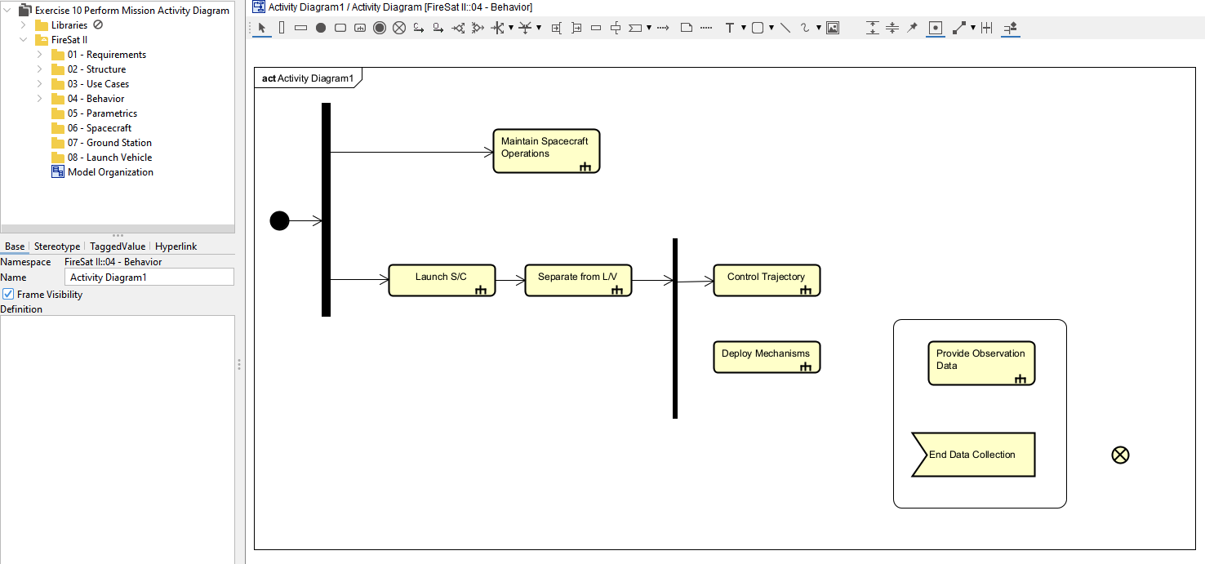
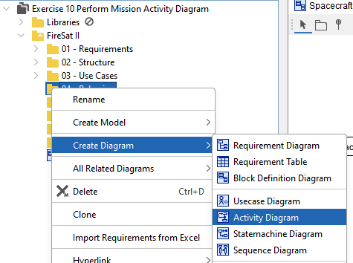
Exercise 10 Perform Mission Activity

Slide 49
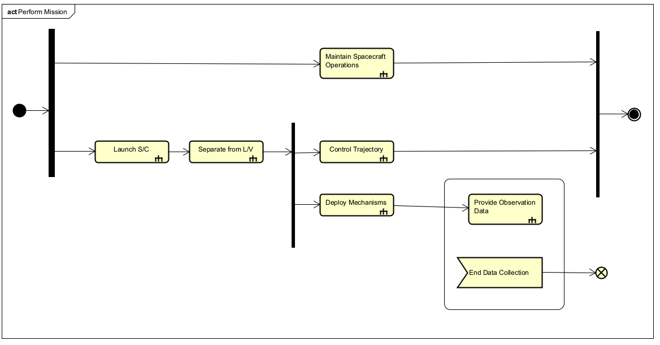
Exercise 10 Perform Mission Activity Complete

Slide 50
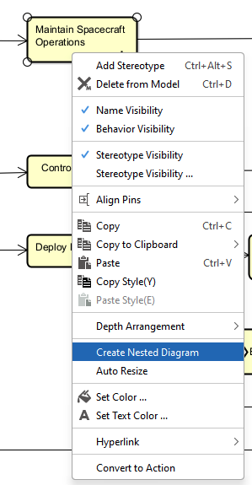
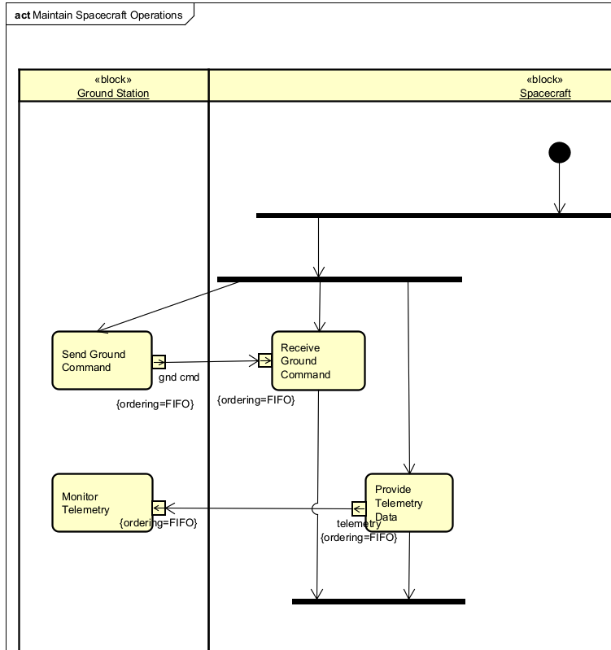
Exercise 10 – CallBehaviorAction

Slide 51
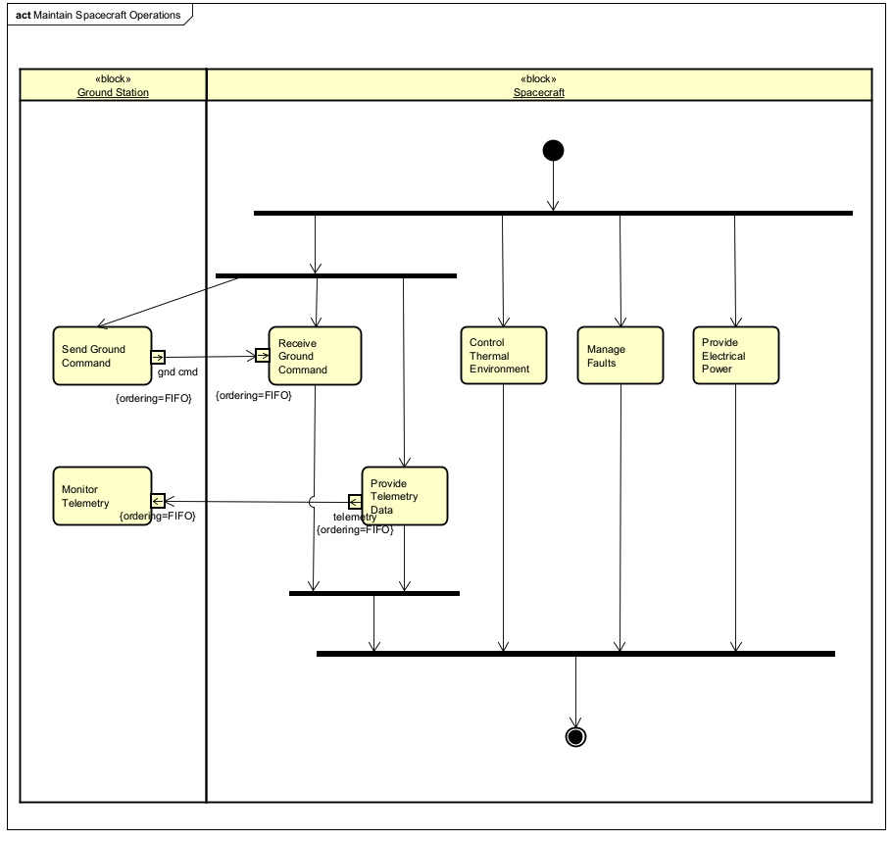
Exercise 10 – Nested Action Diagram

Slide 52
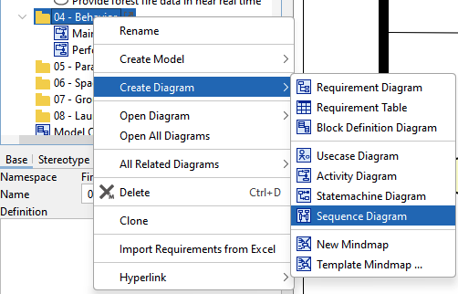
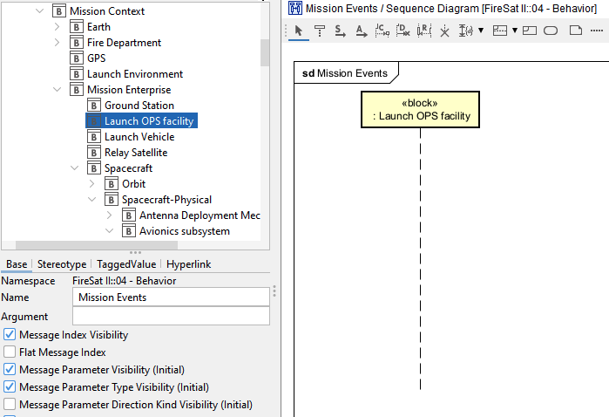
Exercise 11 Sequence Diagram
Once we have the diagram open we:
Give it a name “Mission Events”
Then drag structure blocks onto the diagram

Slide 53
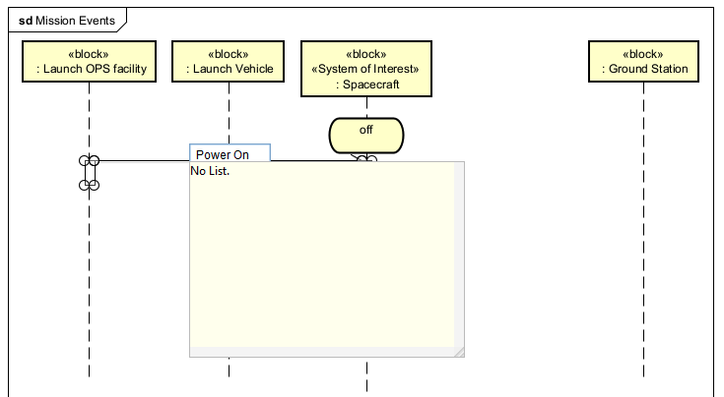
Exercise 11 Sequence Diagram

Slide 54
Exercise 11 Complete Sequence Diagram

Slide 55
Exercise 12 State Machine
Create a State Machine diagram in the Behavior Package
Name it ‘Fault Manager States’
Add a state, name it ‘Fault Monitoring’
Stretch it out to fill most of the diagram frame
Add a state, name it ‘Operations’
Add an initial state (big black dot) on left hand side of Operations state
Add a ‘Normal’ state to the right
Add a ‘Safe’ state further to the right of the Normal state
Draw a transition from initial to ‘Normal’
Draw a transition from ‘Normal’ to ‘Safe’; change the ‘Trigger’ text to ‘Mission Critical Threshold’
Draw a transition from ‘Safe’ to ‘Normal’; change the ‘Trigger’ text to ‘Resume Normal Operations’

Slide 56
Exercise 12 State Machine
Add a state below Operations; label it ‘Error Response’
Add a new initial state centered below Operations
Add three more states; ‘Wait’, ‘Local Response’ & ‘System Response’
Center the Wait state horizontally, draw a transition from initial to Wait
Draw a transition from ‘Wait’ to ‘Local Response’ – label it ‘Error Detected’
Draw a transition from ‘Local Response’ to ‘Wait’ – label it ‘Error Resolved’
Draw a transition from ‘Local Response’ to ‘System Response’ – label it ‘Error Unresolved’ (umm, Houston we have a problem)
Draw a transition from ‘System Response’ to ‘Wait’ – label it ‘System Response Complete’
Right-click on ‘Local Response’, select ‘Add Action’, ‘Add Entry’ – edit the action to: ‘Send Local Response Request’
Right-click on ‘System Response’, select ‘Add Action’, ‘Add Entry’ – edit the action to: ‘Send System Response Request’

Slide 57
Exercise 12 Complete State Machine

Slide 58
Exercise 13 Parametrics
First, I define the problem, in this case how much power will the satellite components need in order to size the solar panel array?
Then create a BDD of related Constraint blocks – a sum of all component demands, the formula for power (Joule’s Law: power = current * voltage), and the parameters current & voltage

Slide 59
Exercise 13 Parametrics
Next, right-click on the ‘Power Consumption’ constraint block, select ‘Create Diagram’/ ‘Parametric Diagram’
Add the constraints for Joule’s Law & the Power Sum, add connectors for current & voltage inputs, add a connector for the total power calculation output

Slide 60
Allocations – Relationship Magic
The power of SysML modeling isn’t in individual diagrams, it’s in the relationships between the model elements which you can see from different perspectives
Requirements are allocated to structures
<<satisfy>> <<verify>> <<trace>>
Behaviors are allocated to structures
Behaviors are allocated requirements
<<refine>>
Behaviors are allocated to activities
Actions are allocated to part properties
Logical structures are allocated to physical structures
e.g. a Logical block to a Physical block
e.g. software to a hardware element
Resources are allocated to structures³

Slide 61
References
Architecting Spacecraft with SysML, S. Friedenthal and C. Oster, CreateSpace Independent Publishing Platform, © 2017
Practical Guide to the Systems Modeling Language (SysML), Third Edition, S. Friedenthal, A. Moore, and R. Steiner, Morgan Kaufmann Publishers, © 2015, 2012, 2009 Elsevier Inc.
SysML Distilled, L Delligatti, Pearson Education, Inc. © 2014
Astah SysML 9.0.0, © 2006-2024 Change Vision, Inc. (includes software developed by the Apache Software Foundation http://www.apache.org), retrieved from https://astah.net July 2024
Object Management Group website, https://www.omgsysml.org/what-is-sysml.htm
Agile Systems Engineering, B.P. Douglas, Morgan Kauffman, © 2016
Use Cases: Requirements in Context, 2nd Edition, Kulak & Guiney, Addison-Wesley, © 2004

